Slide 1
Lead Score Case Study
Submitted by
Uday Surya Reddy Adala
Vinod K

Slide 2
Lead Score Case Study for an Education Company:
Problem Statement:
To guide the education company named X on their online course over conversion rate of leads
The lead conversion rate should be 80 percent

Slide 3
Strategy to be followed:
Importing Data
Data Preparation and cleaning
Imputing missing values, outlier handling, error handling
Feature scaling
Test and train sets split
Dropping columns based on correlations
Model Building
Evaluating the model by using different metrics - Specificity and Sensitivity or Precision and Recall.
Applying the best model in Test data based on the Sensitivity and Specificity Metrics.

Slide 4
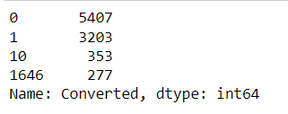
Intermediate methods that are followed:
Different type of values are present in the Target Variable ‘Converted’ which has been converted.
These records are dropped as only expected values are either 0 or 1.

Slide 5
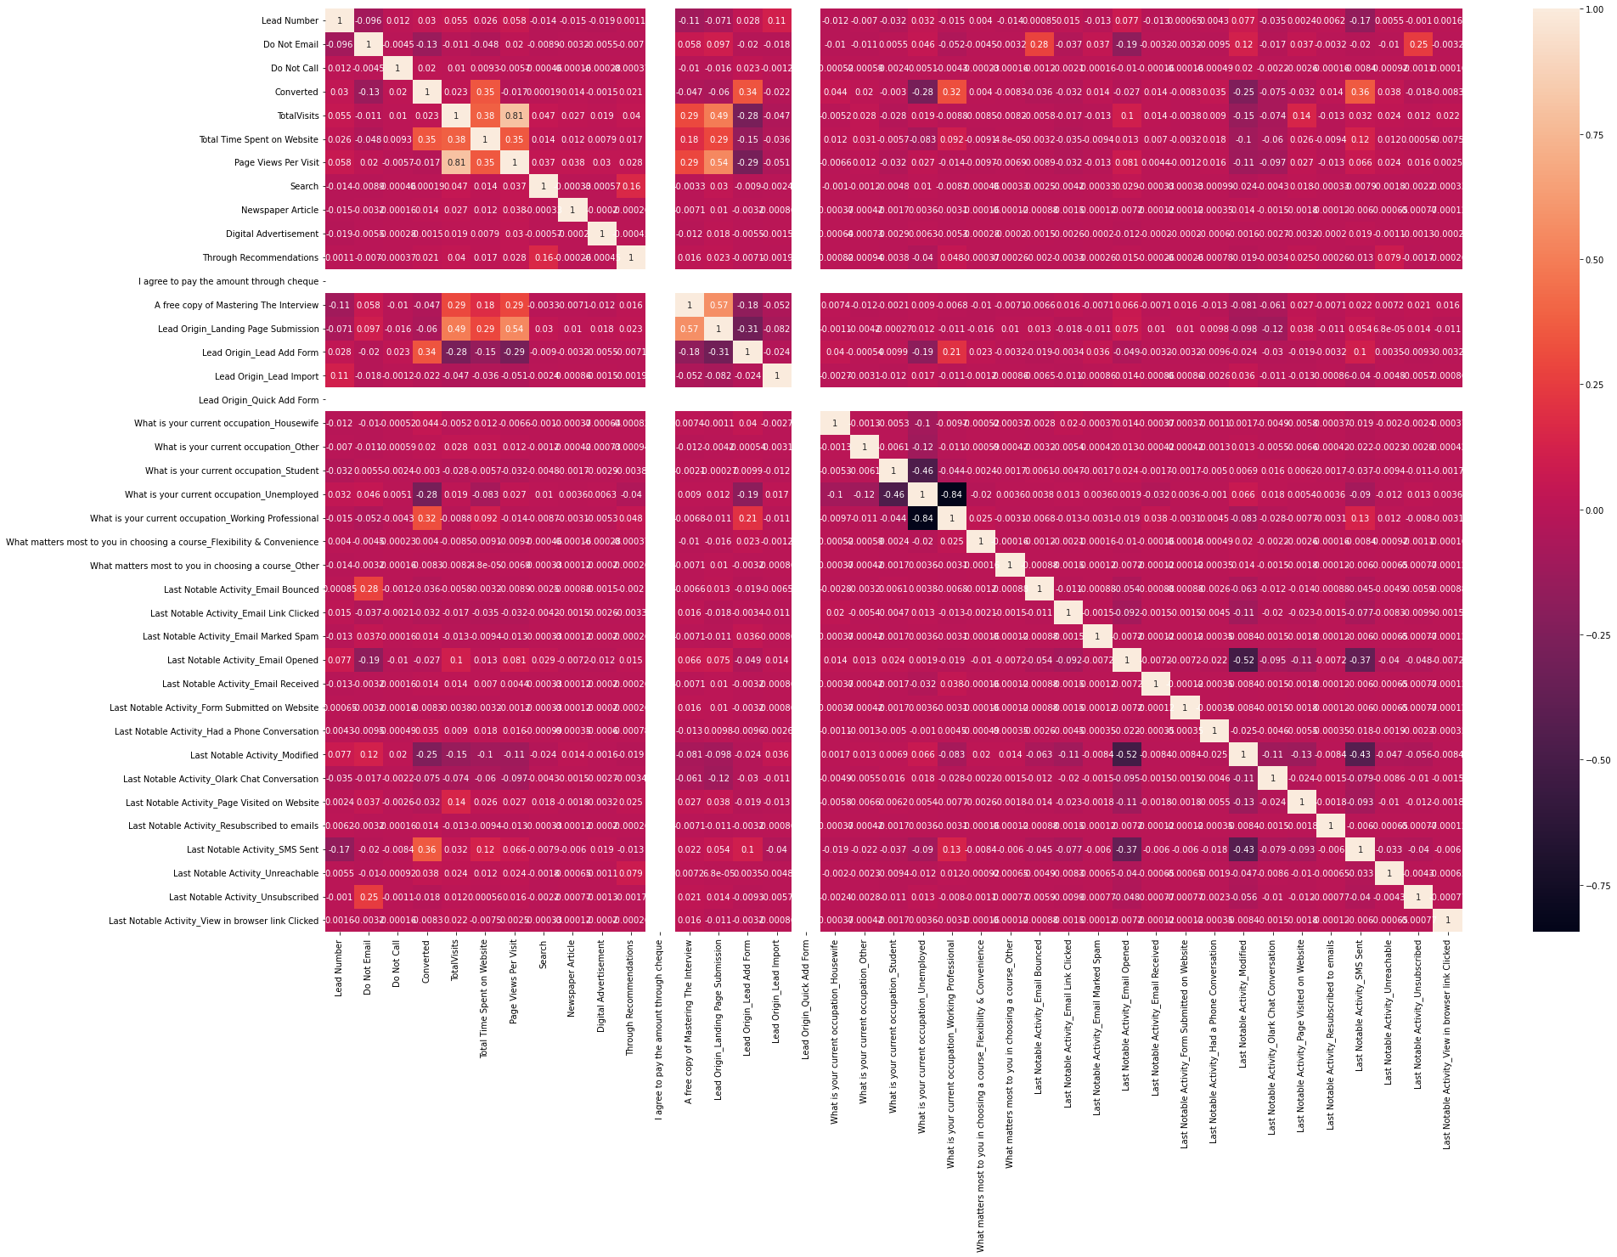
Intermediate methods that are followed:
Drop the variables which are highly co-realted using heat map

Slide 6
Intermediate methods that are followed:
Below are the variables that are dropped after following co-relation matrix
1) What is your current occupation_Unemployed
2)Last Notable Activity_Modified
3) Last Notable Activity_SMS Sent
4) Last Notable Activity_Email Bounced
5) Last Notable Activity_Unsubscribed
6) Lead Origin_Landing Page Submission
7) Page Views Per Visit
8) A free copy of Mastering The Interview

Slide 7
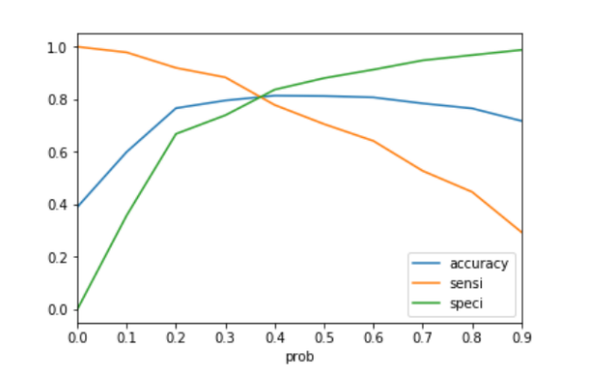
Model Evaluation - Sensitivity and Specificity on Train Data Set
The graph shows that the optimal cutoff is near 0.4.
Accuracy when cutoff is 0.4: 0.808338476

Slide 8
Model Evaluation - Sensitivity and Specificity on Train Data Set
Confustion matrix:
[3267, 515]
[670, 1573]
Sensitivity:0.7412
Specificity: 0.8243
Accuracy: 0.80338

Slide 9
Model Evaluation – Sensitivity and Specificity on Test Dataset
Confustion matrix:
[1401, 222]
[264, 696]
Sensitivity:0.76503
Specificity: 0.86321
Accuracy: 0.81184

Slide 10
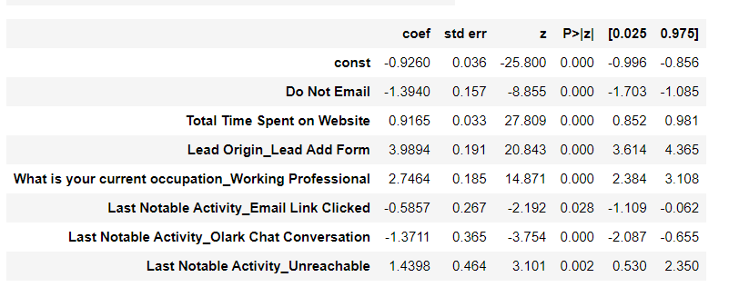
Variables Impacting the Conversion Rate

Slide 11
Conclusion
According to the coefficients of our model, below are the top three variables which contribute most towards probability:
1.Lead Add form (from lead Origin)
2. Working Professional (from What is your current occupation)
3. Unreachable ( from Last Notable Activity)
Following the above variables and a hard cutoff of 0.4 is enough to get 80 percent accuracy
Near 80 conversion rate
And 86 percent specificity

Slide 12
Thank you

